Slide 1
DEEP LEarNiNg MastEr Class
Day-10

Slide 2
01
Batch normalization
Concept

Slide 3
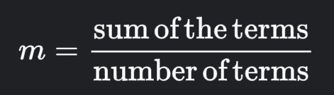
MEAN
For a data set, the arithmetic mean, also known as arithmetic average, is a central value of a finite set of numbers
The sum of the values divided by the number of values

Slide 4
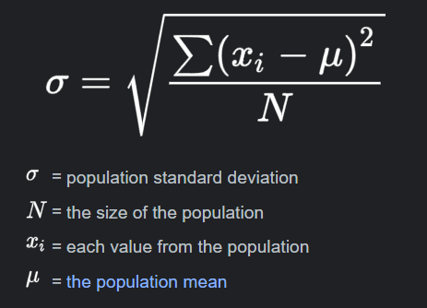
Standard deviation
The standard deviation is a measure of the amount of variation or dispersion of a set of values.
A low standard deviation indicates that the values tend to be close to the mean of the set, while a high standard deviation indicates that the values are spread out over a wider range

Slide 5
Normalization
The process of converting an actual range of values into a standard range of values, typically -1 to +1 or 0 to 1.
For example, suppose the natural range of a certain feature is 800 to 6,000.
Through subtraction and division, you can normalize those values into the range -1 to +1.

Slide 6
Batch normalization
To automatically standardize the inputs to a layer in a deep learning neural network
The layer will transform inputs so that they are Standardized, meaning that they will have a mean of zero and a standard deviation of one. – STANDARD NORMAL DISTRIBUTION
During training, the layer will keep track of statistics for each input variable and use them to standardize the data
Benefits
Make neural networks more stable by protecting against outlier weights.
Enable higher learning rates.
Reduce overfitting.

Slide 7
Batch normalization
BatchNormalization(momentum=0.0)
A “momentum” argument allows you to control how much of the statistics from the previous mini batch to include when the update is calculated.
By default, this is kept high with a value of 0.99. This can be set to 0.0 to only use statistics from the current mini-batch

Slide 8
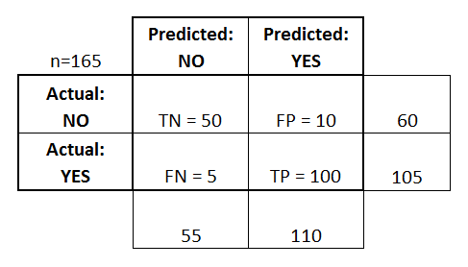
Deep Learning Terminology - 1
Confusion matrix
An NxN table that summarizes how successful a classification model's predictions were
One axis of a confusion matrix is the label that the model predicted, and the other axis is the actual label
Accuracy - (TP+TN)/total
Misclassification Rate/Error Rate - (FP+FN)/total
True Positive Rate/Sensitivity/Recall - TP/actual yes
False Positive Rate - FP/actual no
True Negative Rate - TN/actual no
Precision - TP/predicted yes
Prevalence - actual yes/total

Slide 9
Deep Learning Terminology - 2
Convergence
A state reached during the training of a model when the loss changes very little between each iteration.
Classification Types
Binary Classification
Multiclass Classification
Multilabel Classification
Imbalanced Classification

Slide 10
Deep Learning Terminology - 3
Downsampling
Reducing the amount of information in a feature in order to train a model more efficiently
Before training an image recognition model, downsampling high-resolution images to a lower-resolution format
In a class-imbalanced dataset, models tend to learn a lot about the majority class and not enough about the minority class. Downsampling helps balance the amount of training on the majority and minority classes.

Slide 11
How to win & Influence People
Short bytes – D10
Book Reads

Slide 12
Thanks!
Thanks!
Follow Me on LinkedIn : Link in Description
+91 7305845758
Pantechsolutions.net
Ask Your Friends to Participate on this Event

